Slide 1
7/2021/5665 Newby Bridge Hotel, Newby Bridge Removal of external storage area and area of untended garden. Locate 4 guest accommodation pods on prepared pad foundations. Introduce hard landscaping and parking (this follows refusal of application 7/2021/5223)

Slide 2
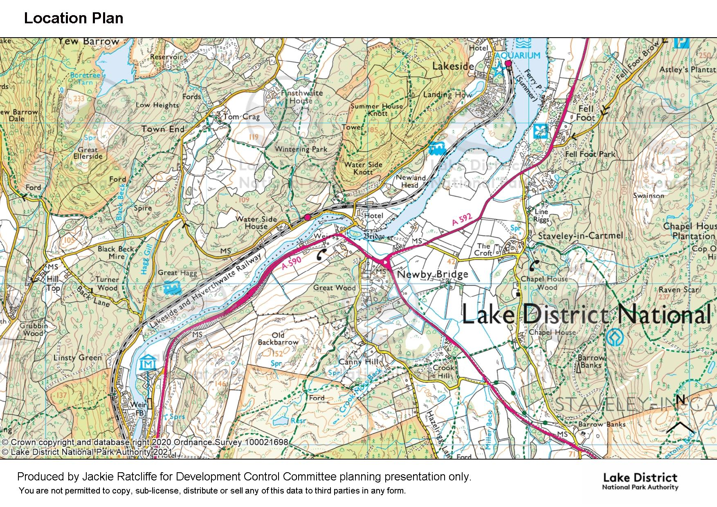
SITE

Slide 3
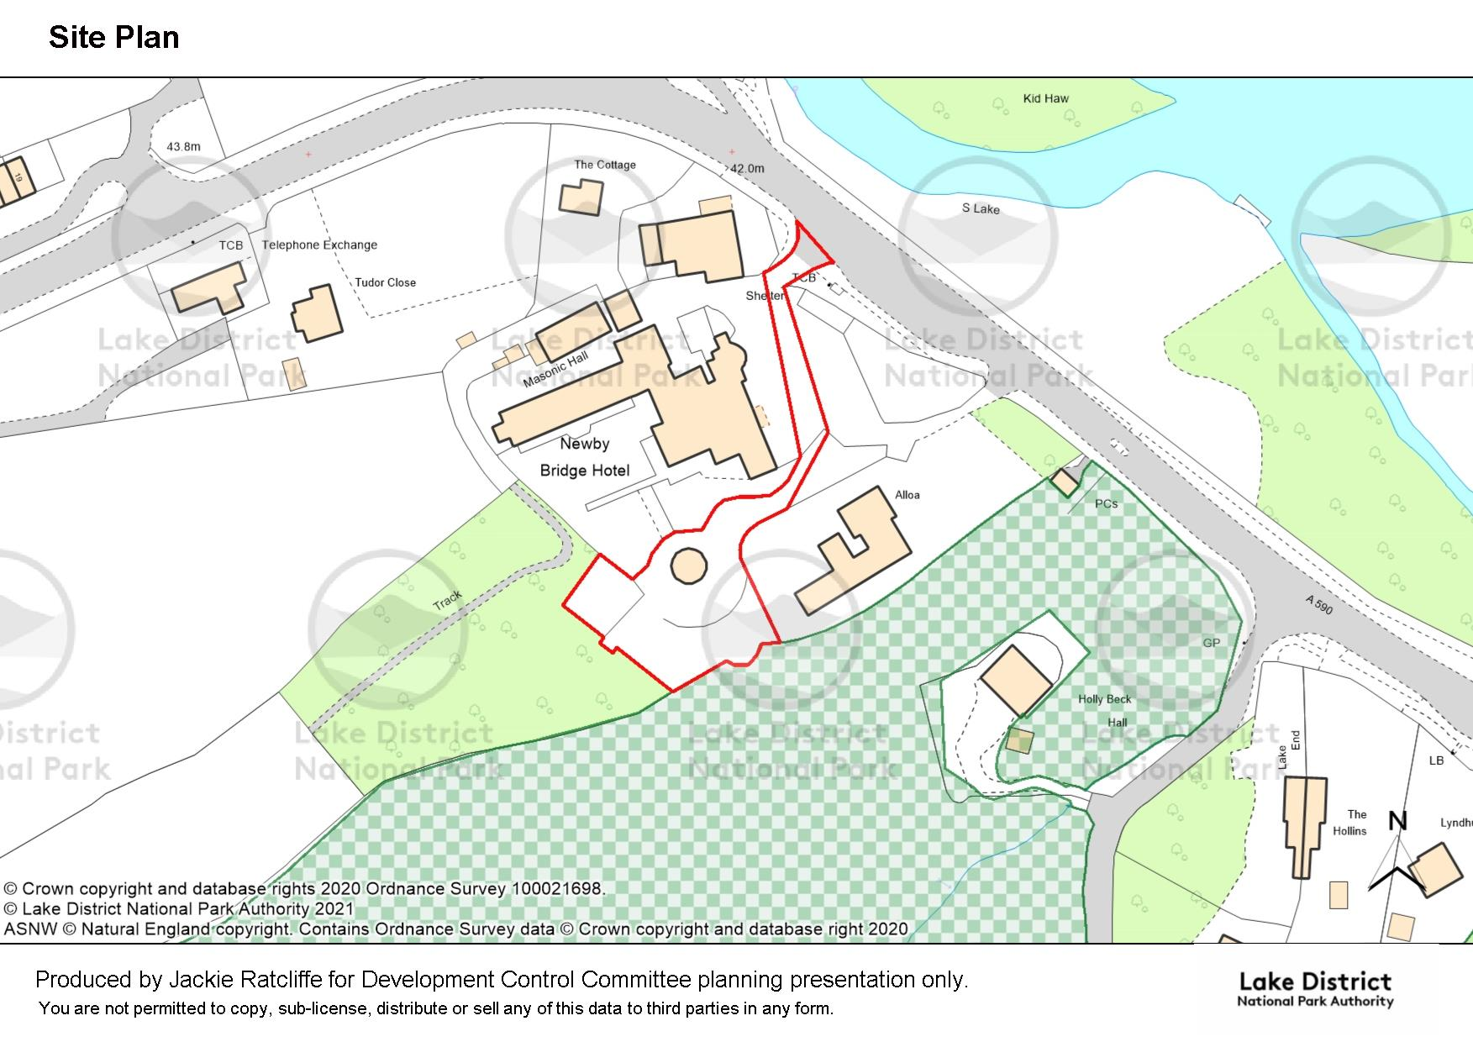
Alloa
SITE
Holly Beck Hall
ASNW
Approx. extent of garden area for Holly Beck Hall

Slide 4
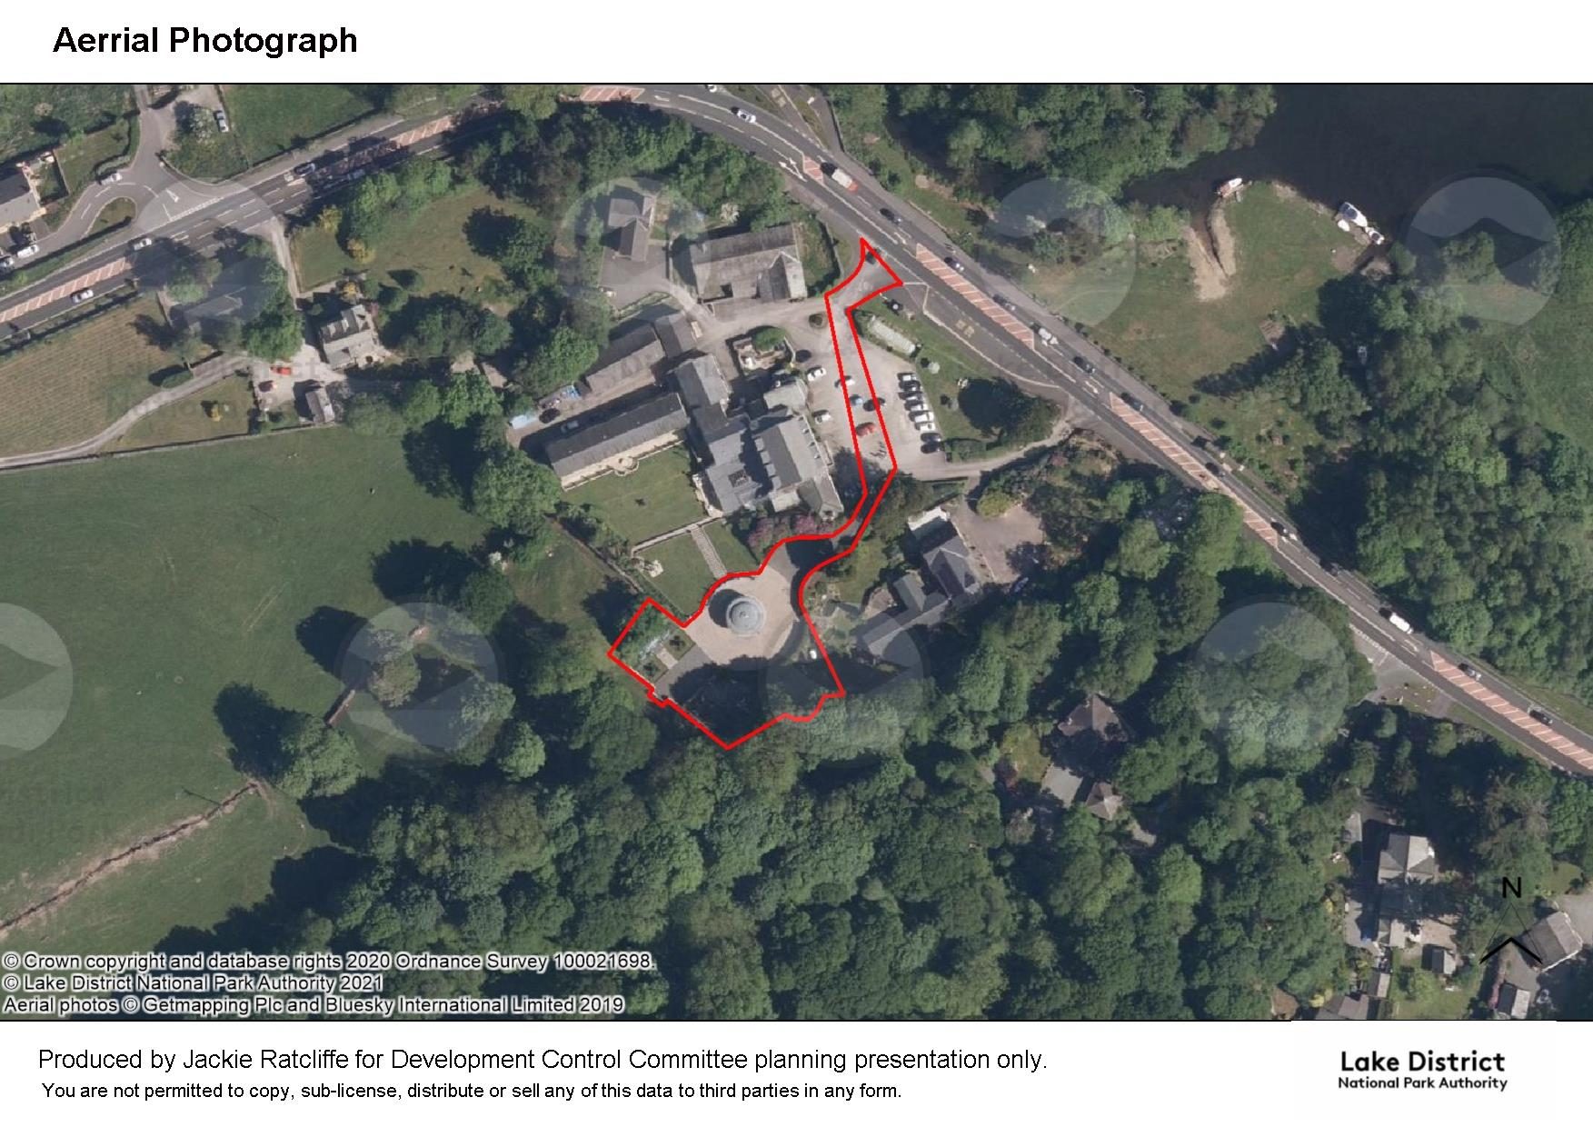

Slide 5
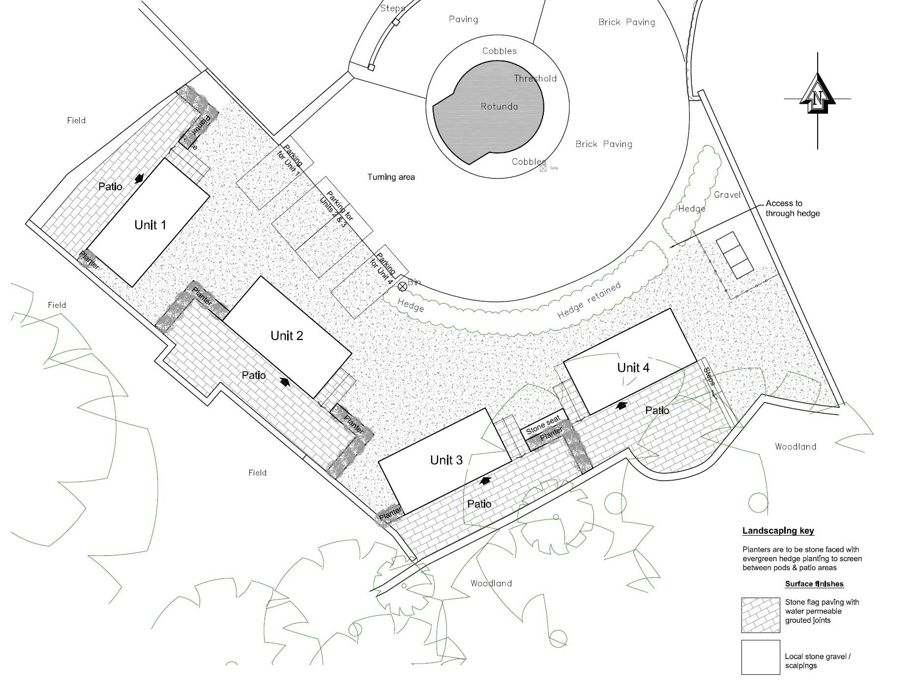
Site layout Plan
Boundary with Alloa
Boundary with Holly Beck Hall and ASNW

Slide 6
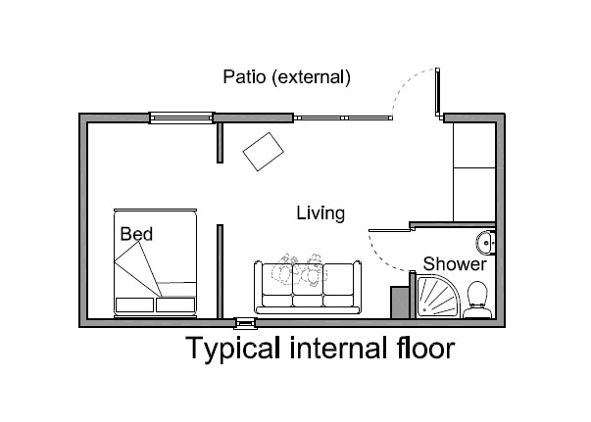
Pod Floor Plan

Slide 7
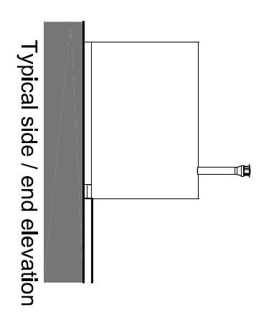
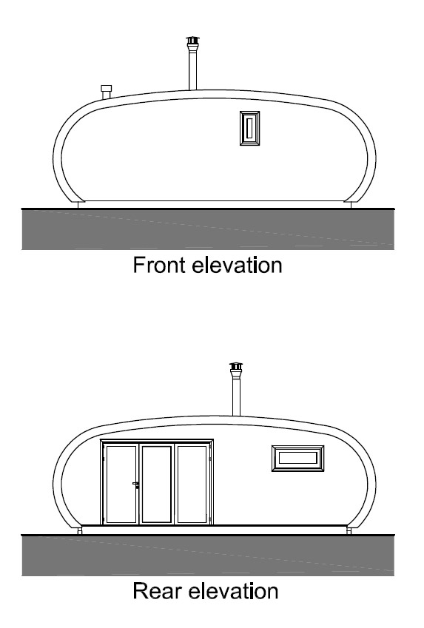
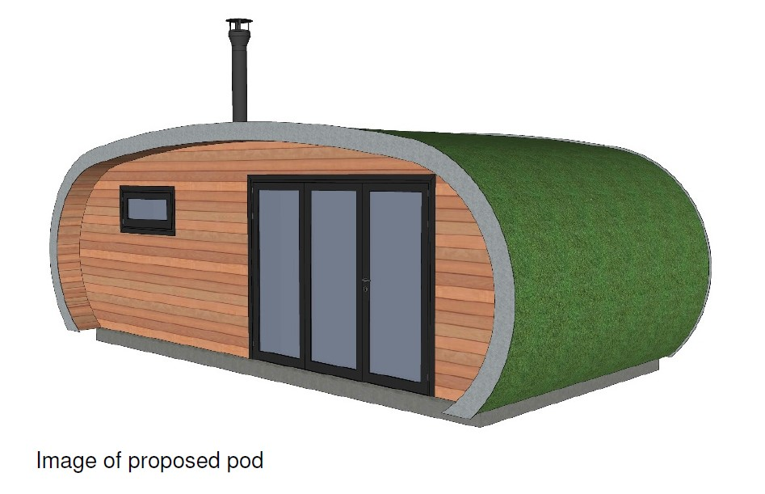
Elevations

Slide 8
Photographs of Pods on Site

Slide 9
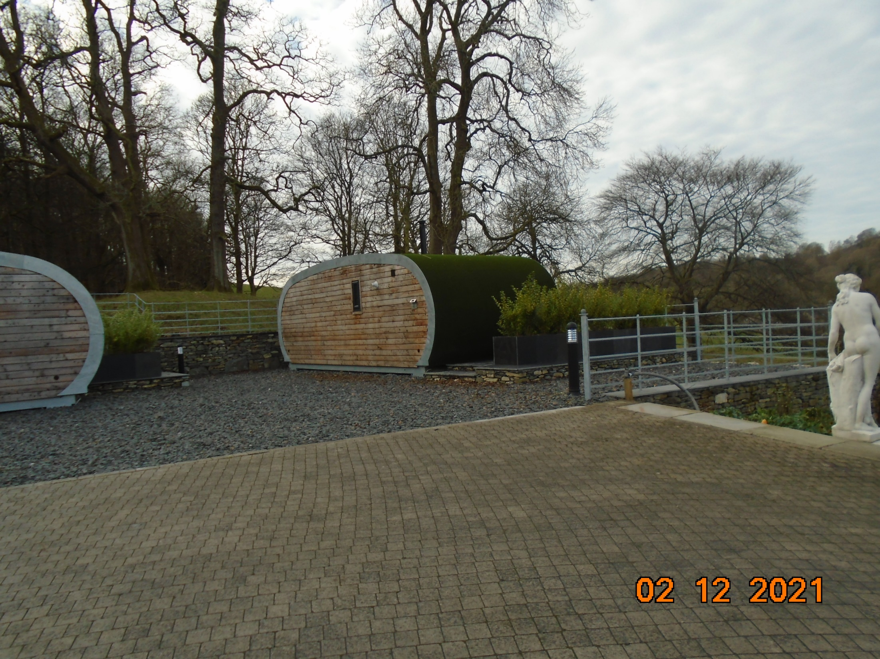
Pod 1 - Looking westwards towards fields

Slide 10
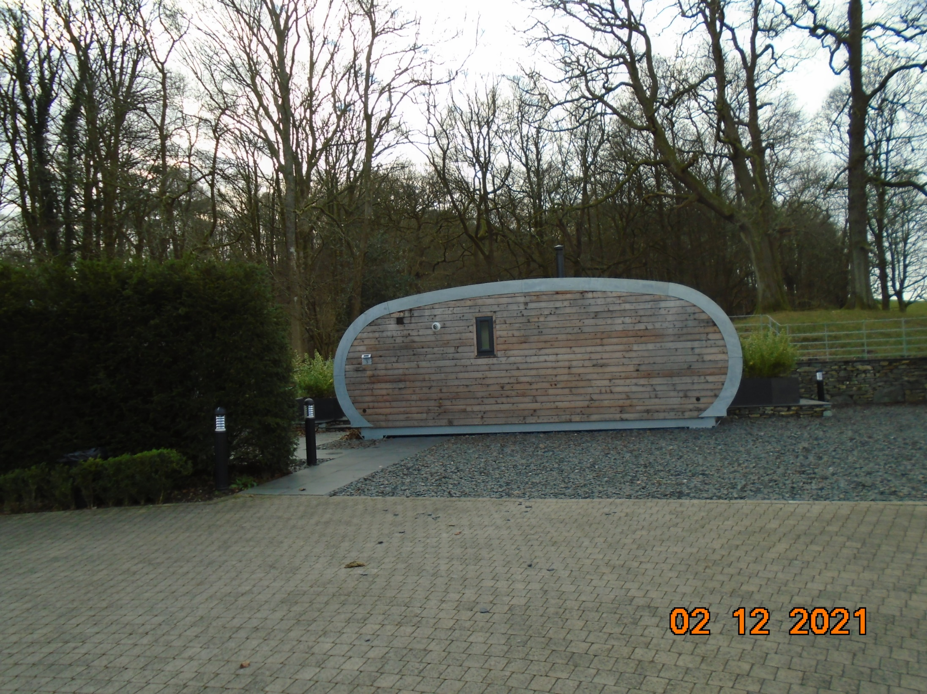
Pod 2 – Looking westwards towards fields and Great Wood

Slide 11
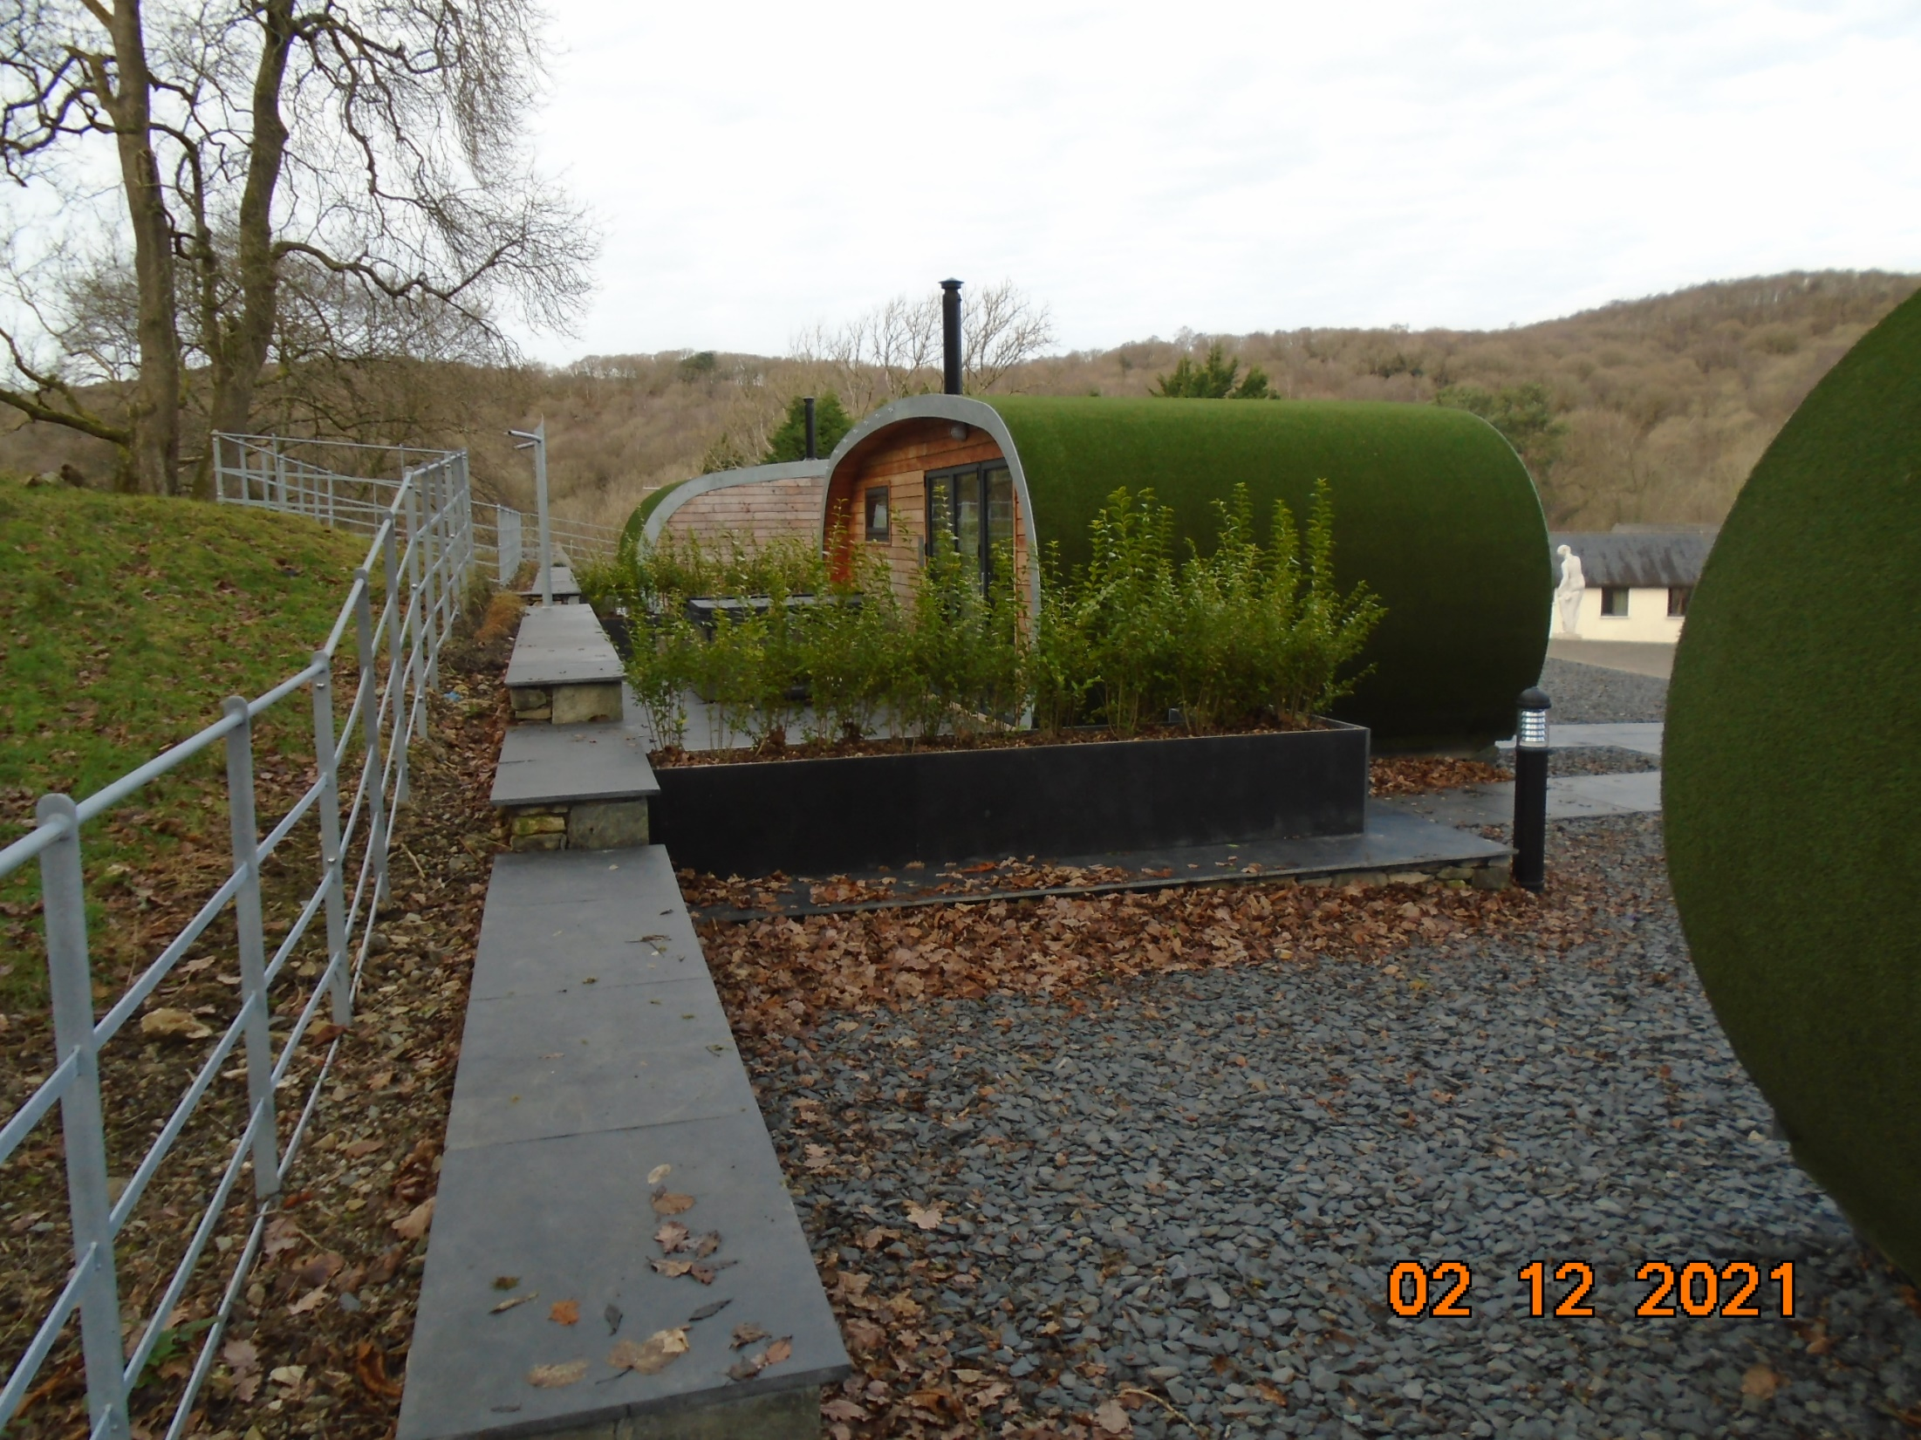
Pods 1 and 2 – Looking north along western boundary

Slide 12
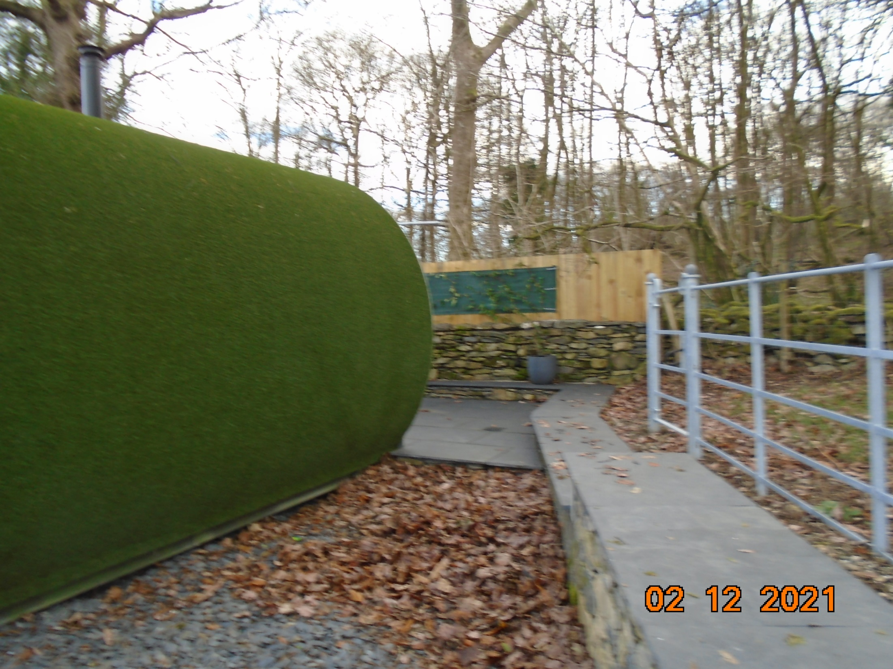
Pod 3 – Looking southwards towards Great Wood and garden area of Holly Beck Hall

Slide 13
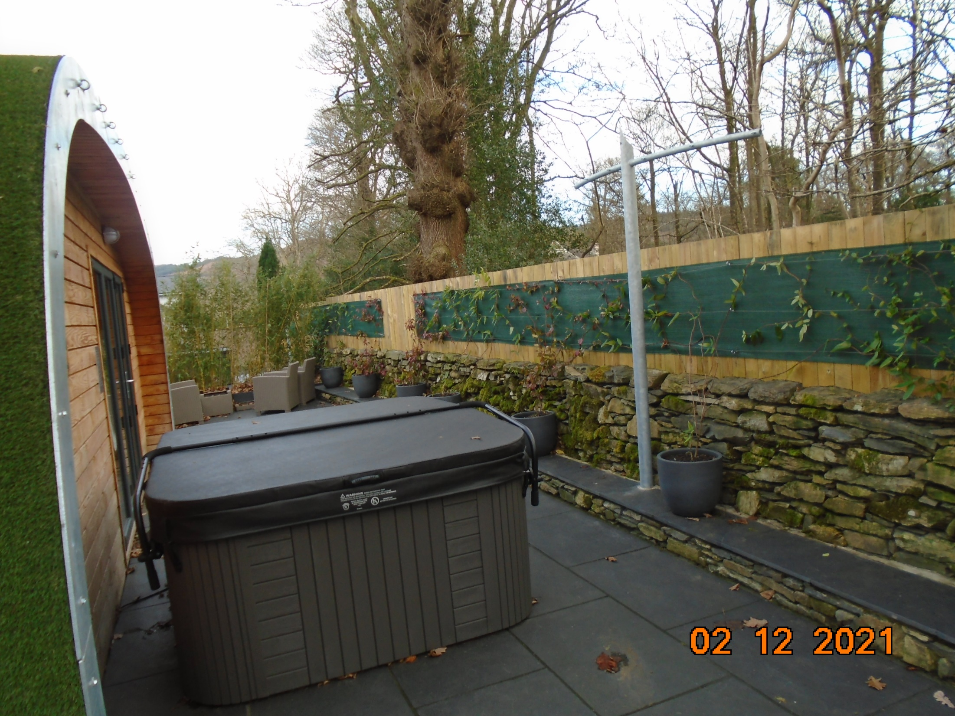
Pod 3 – Looking eastwards along southern boundary with Great Wood and Holly Beck Hall
(Conditions recommended regarding fence to be maintained in situ and at current height, and no further lighting unless agreed with the LPA)

Slide 14
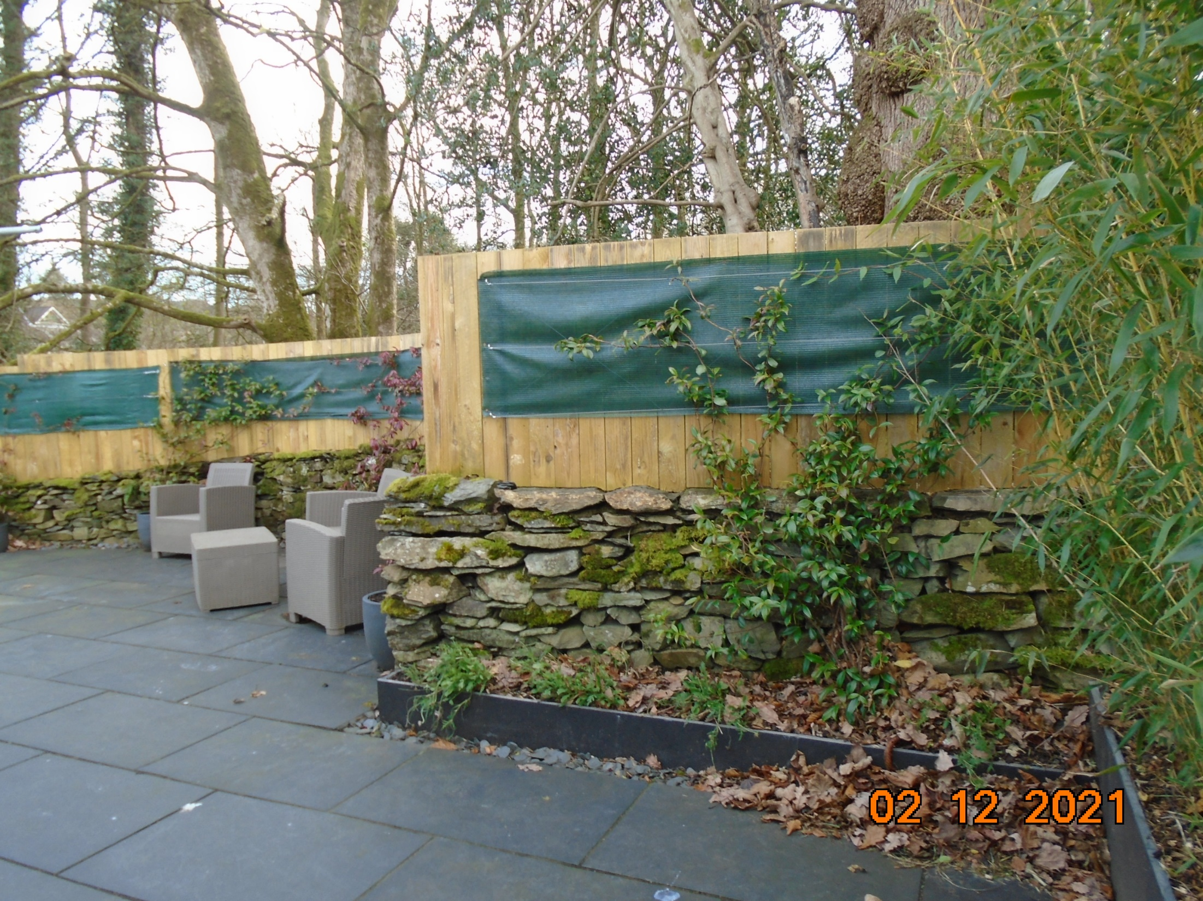
Pod 4 - Patio area looking southwards towards Great Wood and Holly Beck Hall

Slide 15
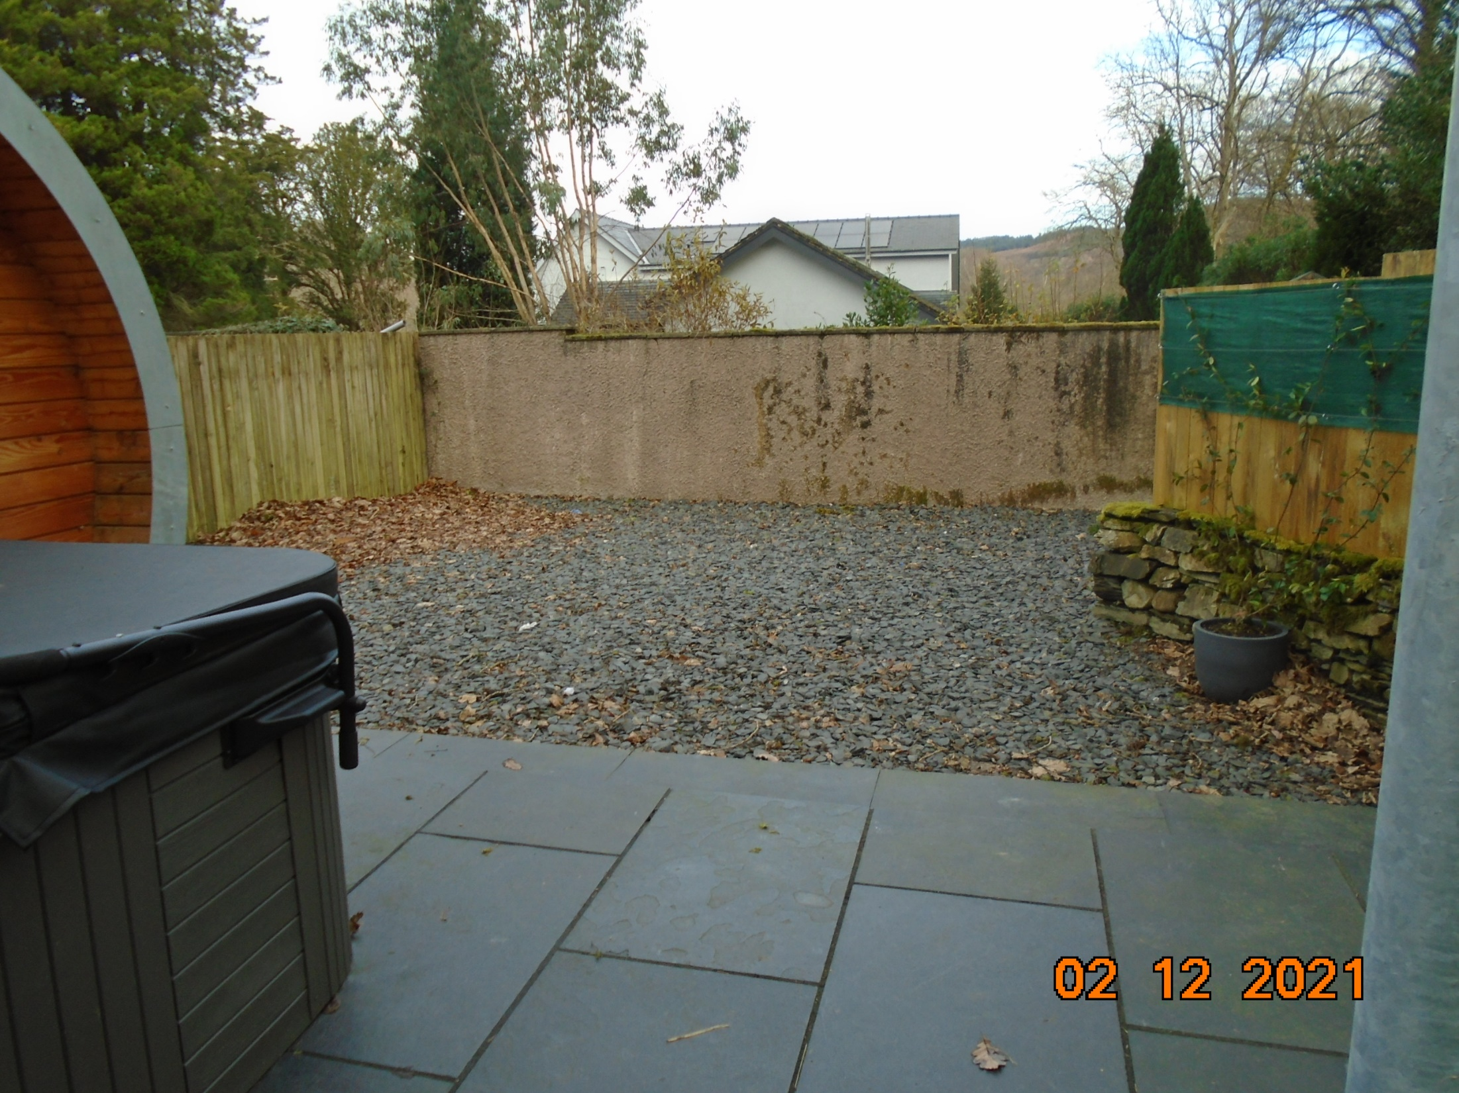
Pod 4 – Patio area looking eastwards towards Alloa
(Condition recommended for 6 metre landscaped area to provide separation)

Slide 16
Photographs taken from Holly Beck Hall Garden

Slide 17
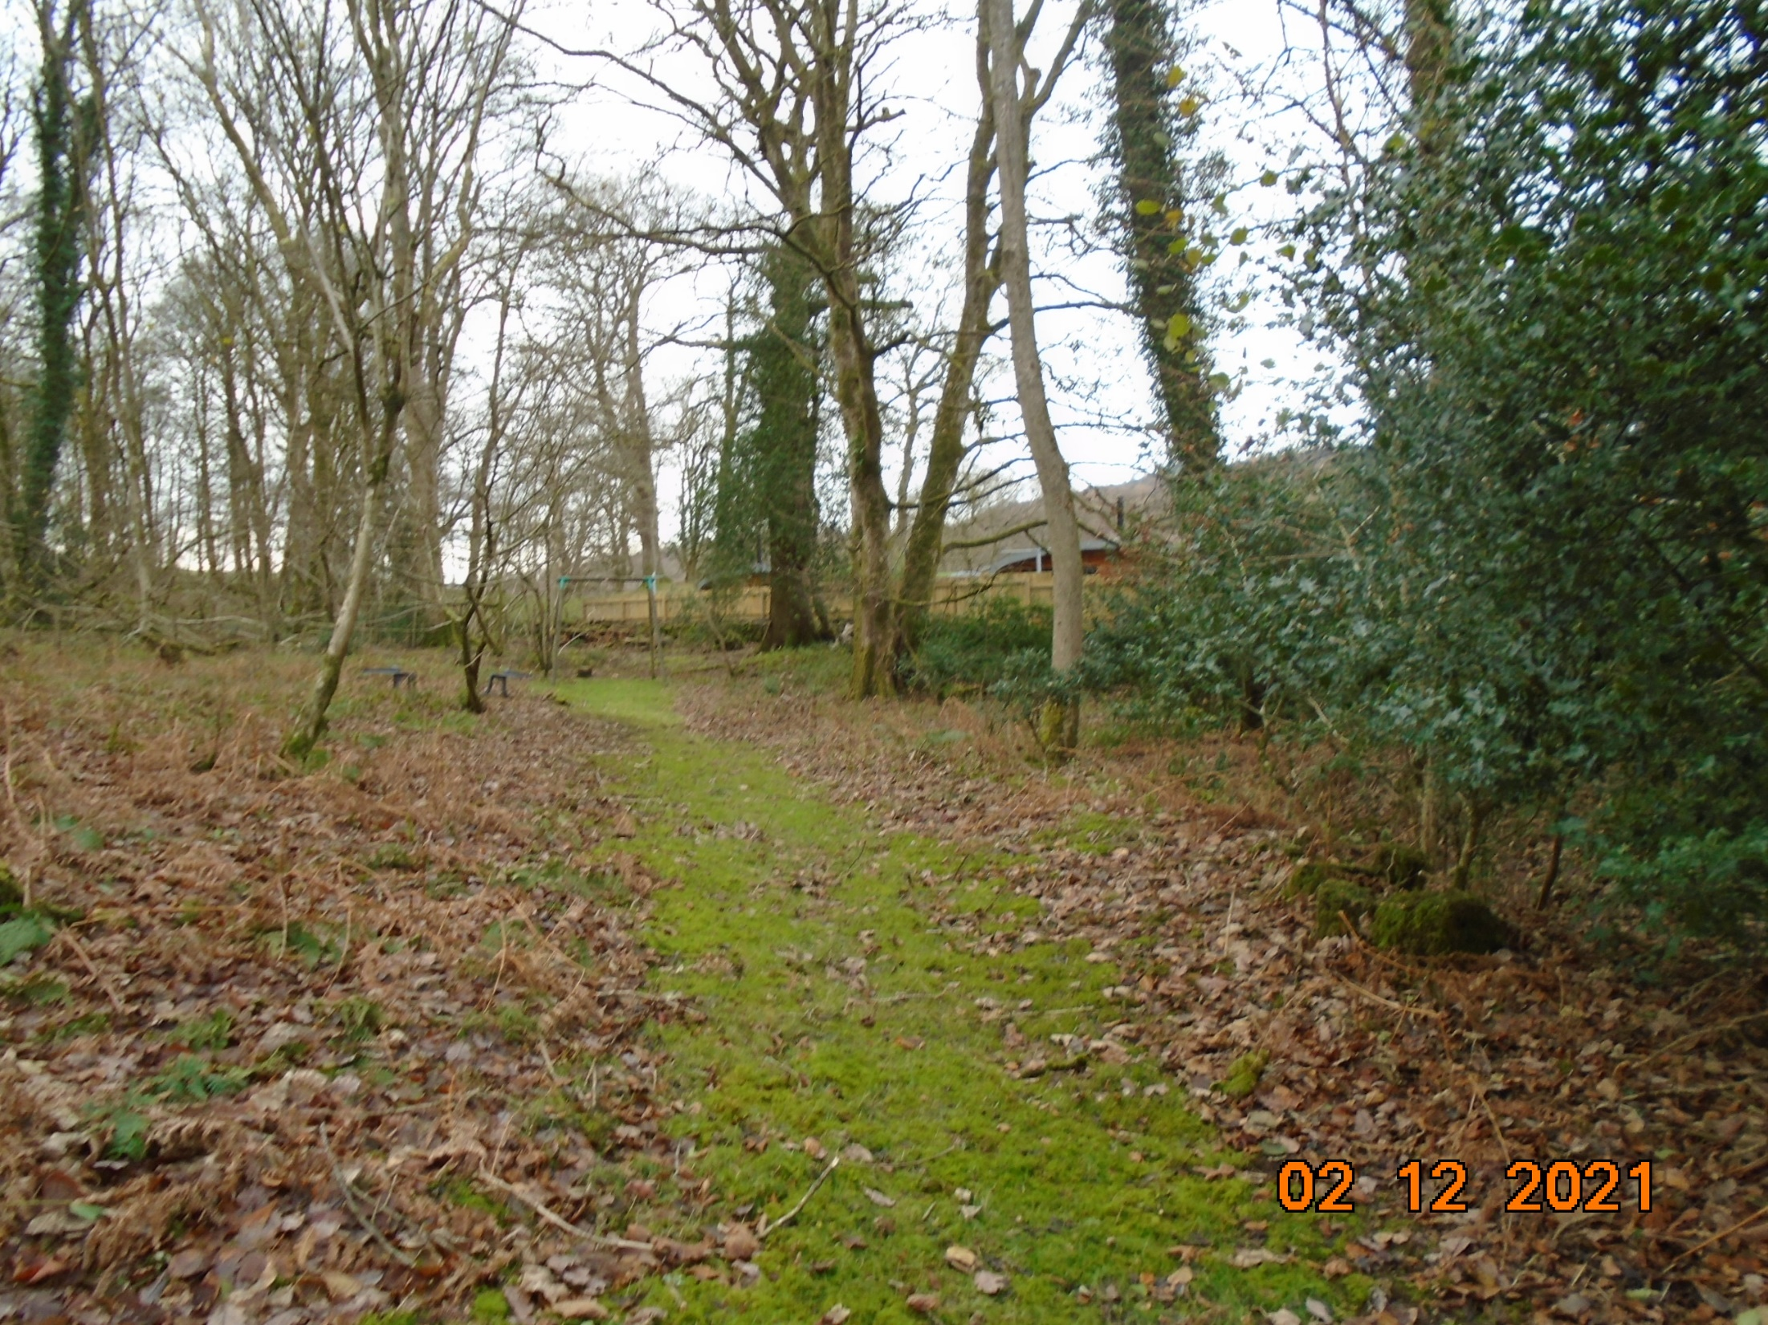
Pod 4
Looking westwards through garden of Holly Beck Hall towards site
Pod 3
Approx. line of west garden boundary
Holly Beck Hall garden

Slide 18
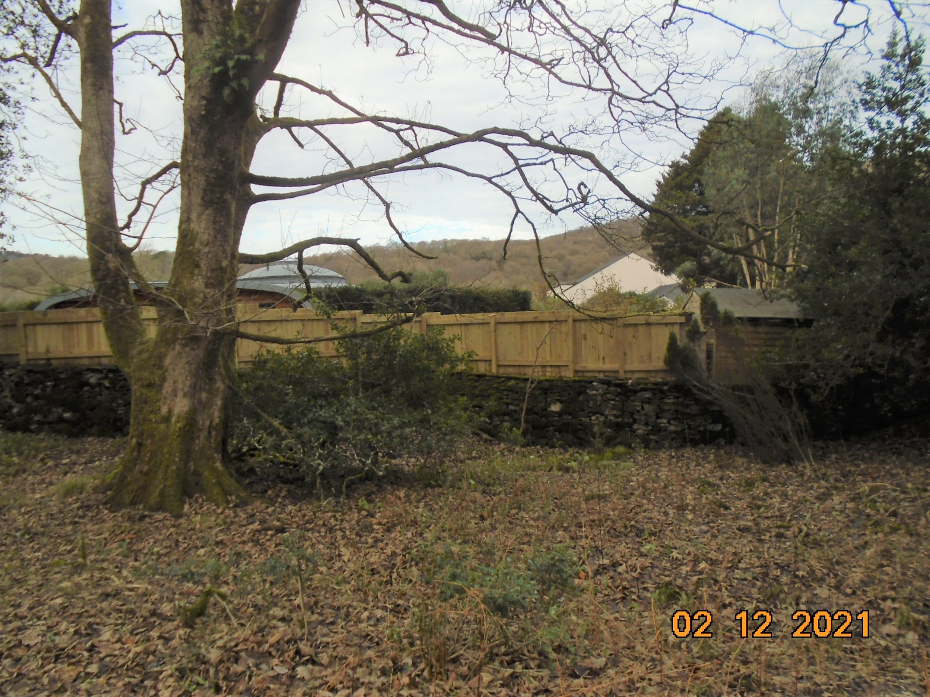
Looking from play equipment northwards towards site
Pod 4

Slide 19
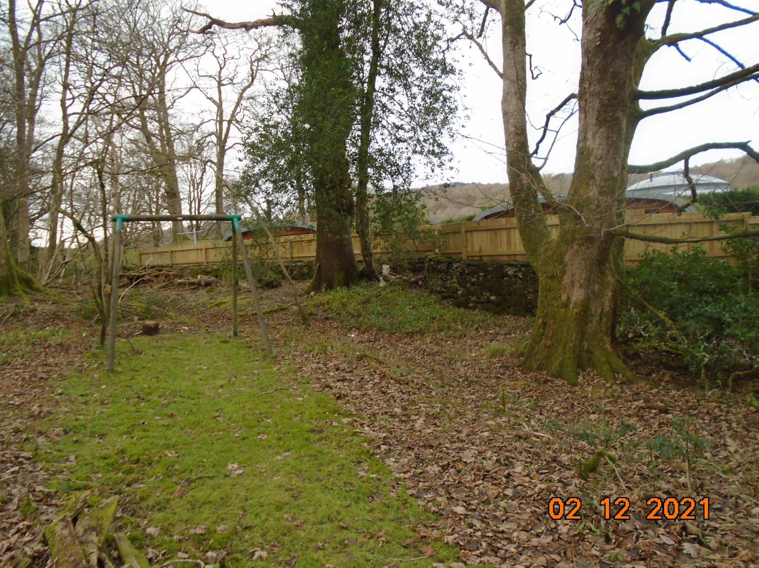
Play equipment in relation to the southern boundary of the site
Pod 4
Pod 3

Slide 20
Photographs taken from Alloa’s garden

Slide 21
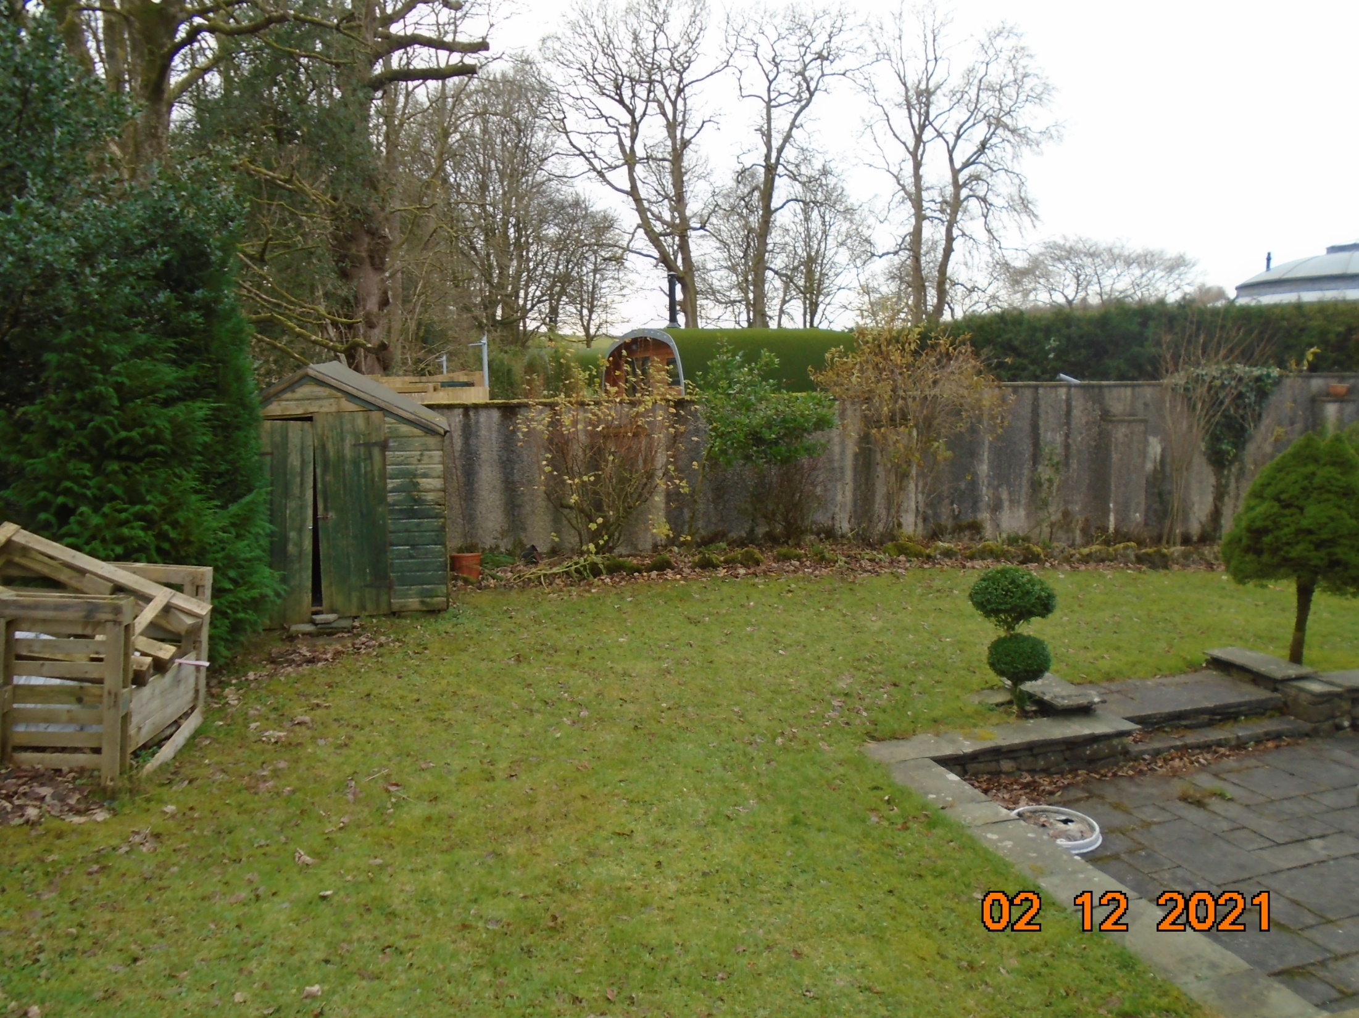
Pod 4
Looking south-westwards towards site from raised area of garden to the south of the swimming pool extension

Slide 22
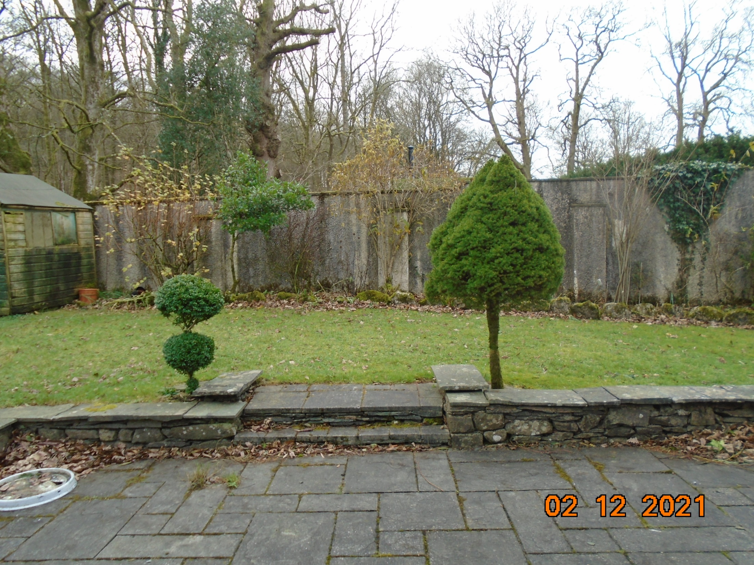
Pod 4
Looking south-westwards towards the site from the patio area between the swimming pool extension and the site

Slide 23
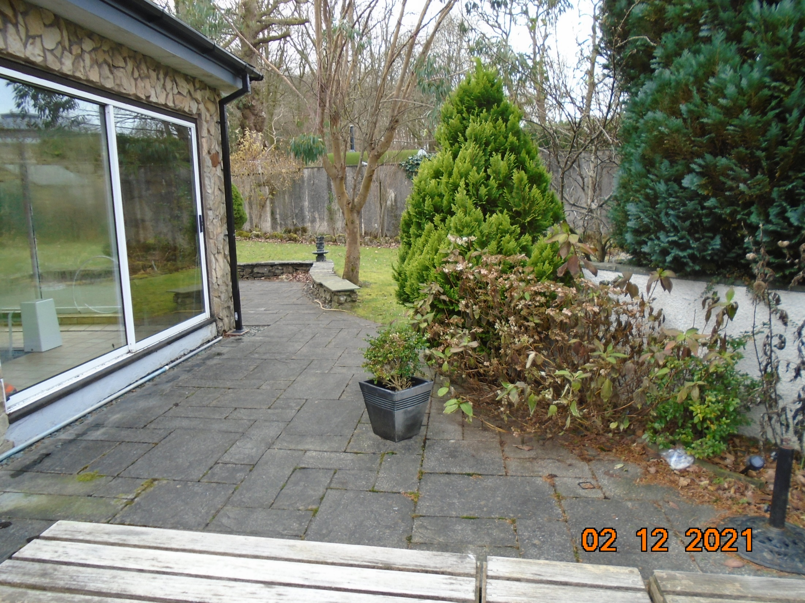
Pod 4
Looking south-westwards from the patio area to the north of the swimming pool extension

Slide 25
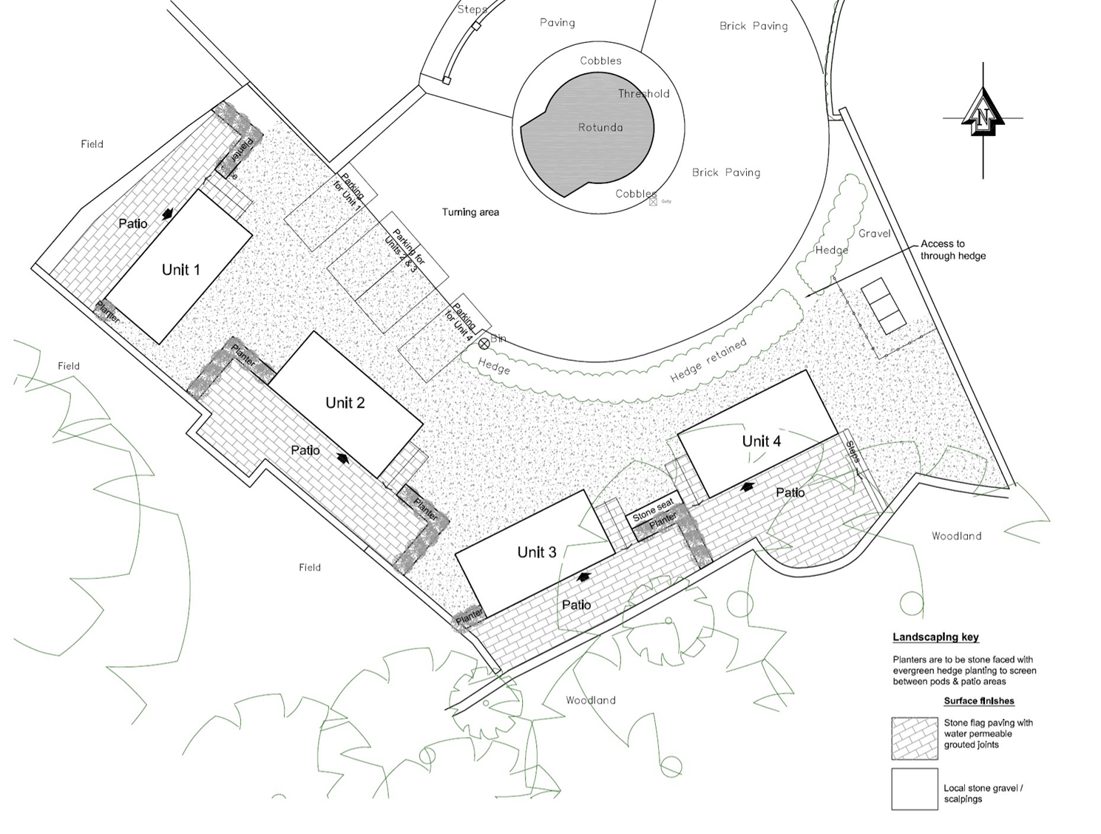
Boundary with Alloa
Boundary with Holly Beck Hall and ASNW

